Slide 1
A common neural basis for contrast and motion coherence discrimination
Dan Birman
Frisem 2017-06-26

Slide 2
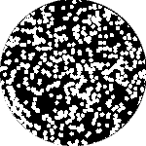

Slide 3
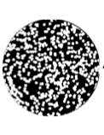
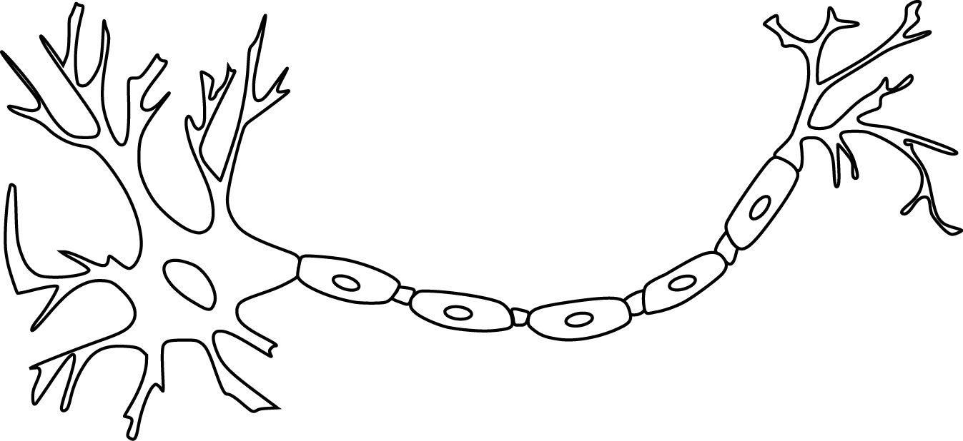

Slide 9
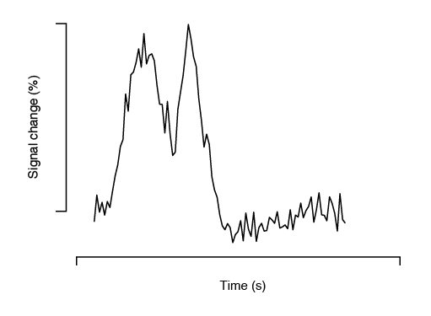

Slide 10
Encoding model of stimulus features

Slide 11
Encoding model of stimulus features
Encode contrast and motion coherence

Slide 12
Encoding model of stimulus features
Encode contrast and motion coherence
Compare to behavior (discrimination)

Slide 19
11 observers, asynchronous fixation task
800+ trials (20 per experimental condition)
1 hr retinotopy
4 x 2 hr scanning sessions

Slide 20
Area V1
Area MT

Slide 21
Within-subject analysis:
Timecourses were averaged across ROIs
Deconvolution used to obtain per-condition timecourses

Slide 30
Encoding model of stimulus features
Encode contrast and motion coherence
Compare to behavior (discrimination)

Slide 31
Encoding model of stimulus features
Encode contrast and motion coherence
Compare to behavior (discrimination)

Slide 35
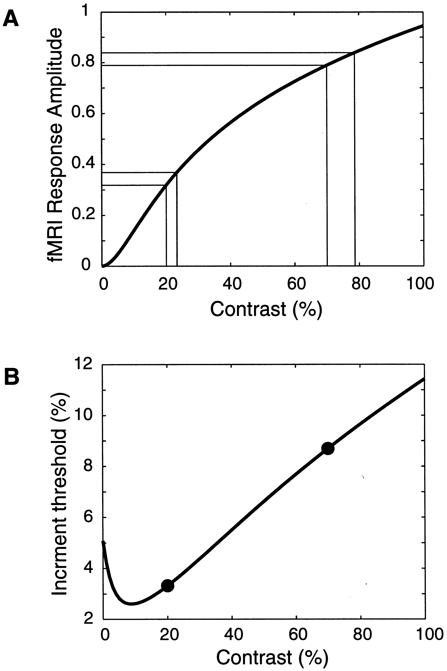
Boynton et al. 1999

Slide 38
Sensitivity = Response / Noise

Slide 43
Encoding model of stimulus features
Encode contrast and motion coherence
Compare to behavior (discrimination)

Slide 44
Attention?
Encode contrast and motion coherence
Compare to behavior (discrimination)

Slide 45

Thanks!
Justin Gardner

